Slide 1
As we grow up, we realise that there are many possibilities for us.

Slide 2
So we thought about what we would like to be when we are all grown up.

Slide 3
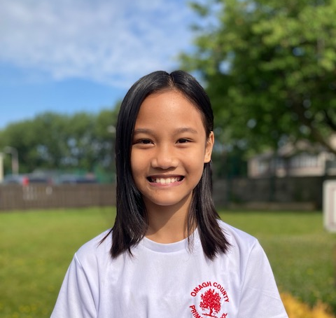
Liana
Doctor

Slide 4
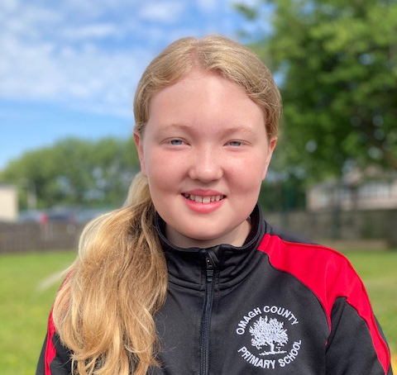
Lexie
Doggie Day Care Centre

Slide 5
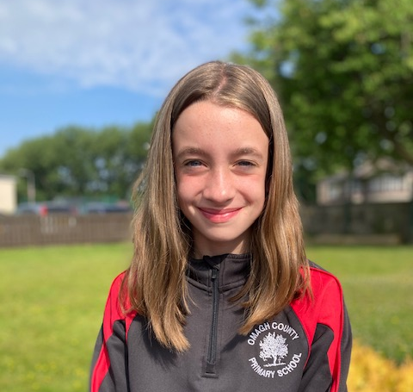
Megan
Solicitor

Slide 6
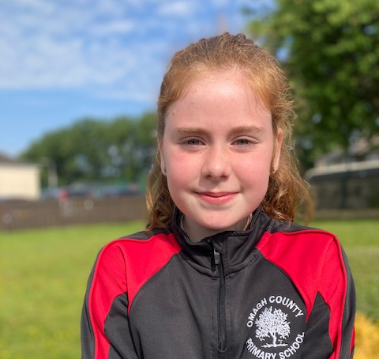
Sarah- Louise
Vet

Slide 7
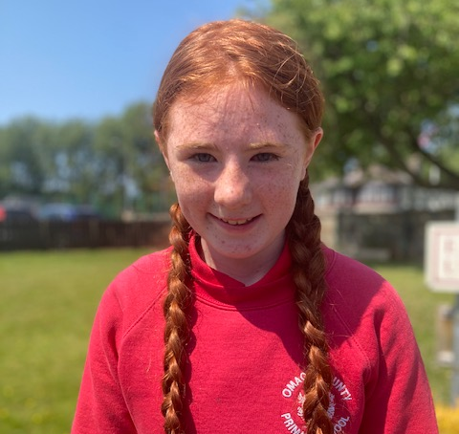
Keira
Dog Groomer

Slide 8
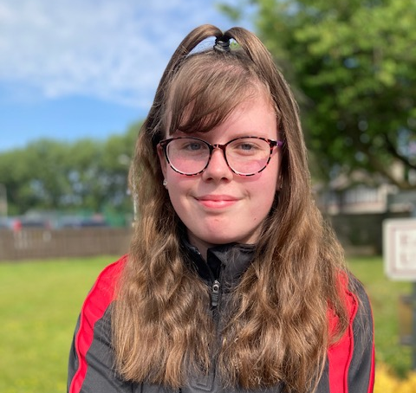
Rihanna
Animal Trainer

Slide 9
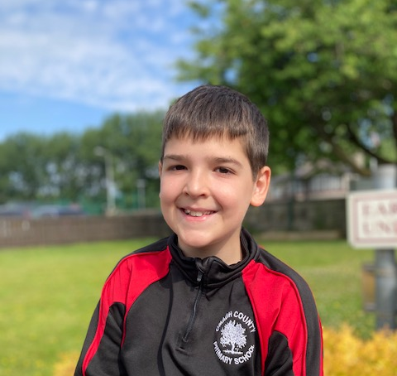
Gabriel
Entrepreneur

Slide 10
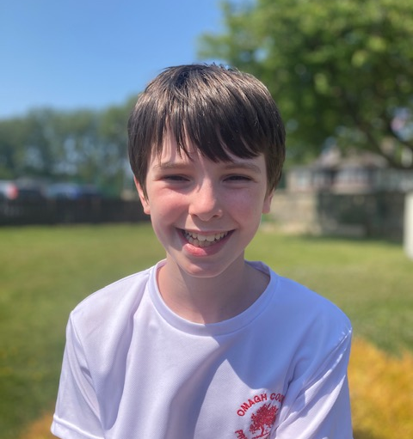
Ben
Footballer

Slide 11
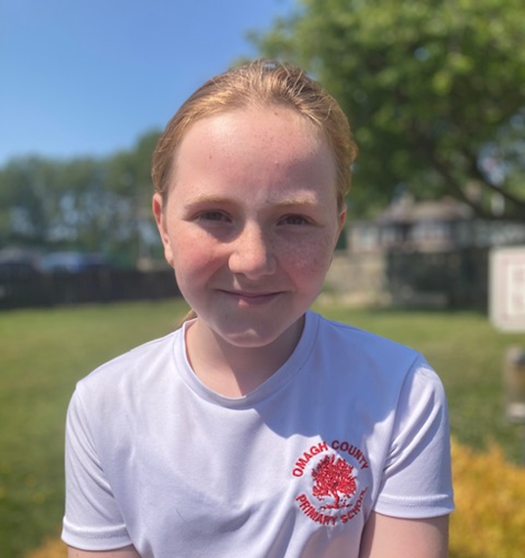
Luca
Hairdresser
Luca
JOB

Slide 12
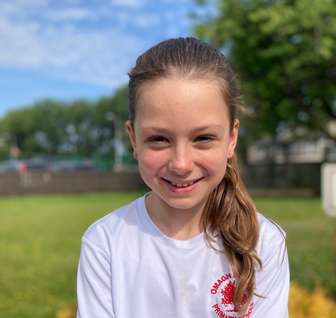
Maddy
Teacher

Slide 13
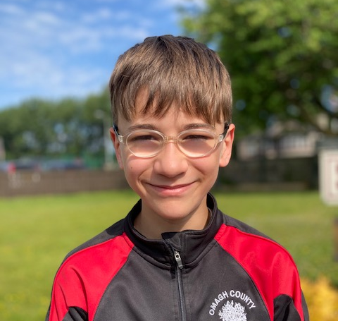
George
Computer Scientist

Slide 14
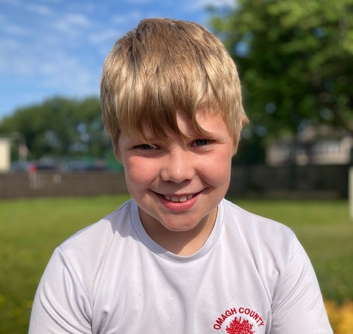
Daniel
Navy Pilot

Slide 15
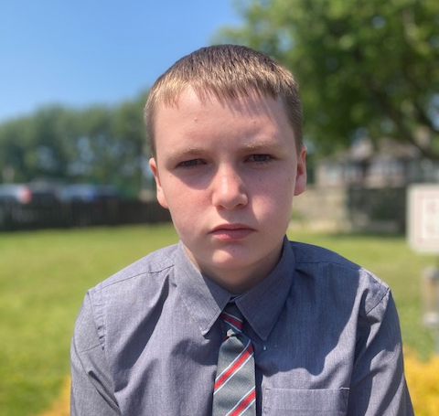
Brendan
Computer Engineer

Slide 16
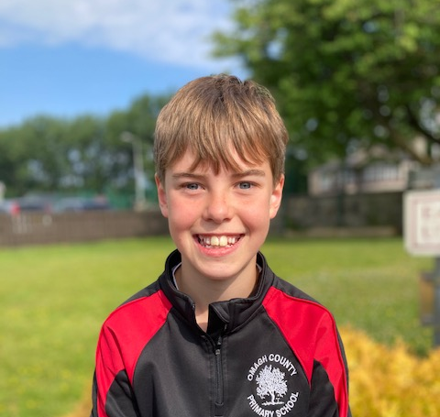
Ryan
Mechanical Engineer

Slide 17
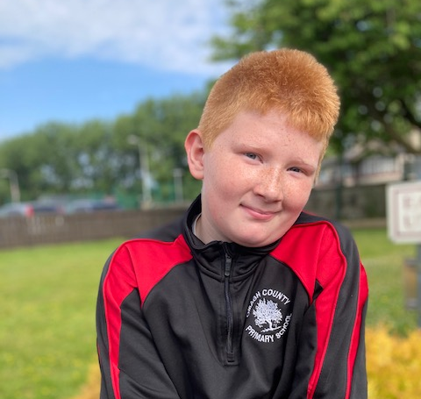
Levi
Police Officer

Slide 18
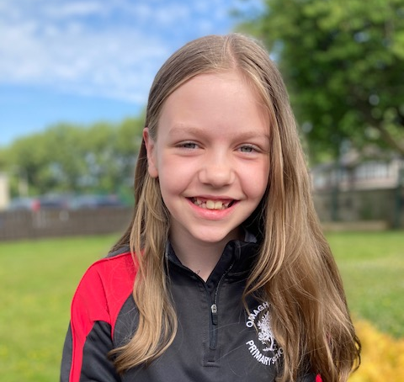
Hollie
Athlete

Slide 19
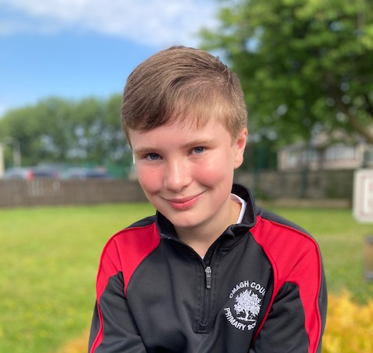
Harry
Footballer

Slide 20
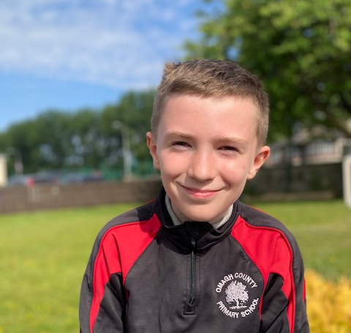
Ben
Historian or Anthropologist

Slide 21
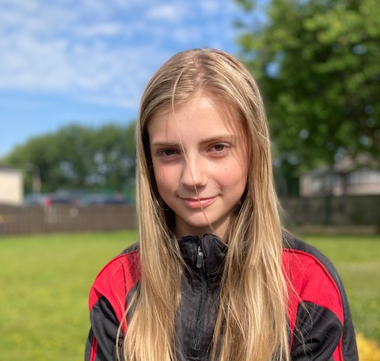
Scarlett
Interior Designer

Slide 22
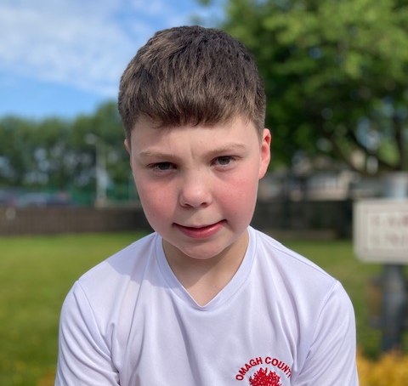
Jack
Rugby Player

Slide 23
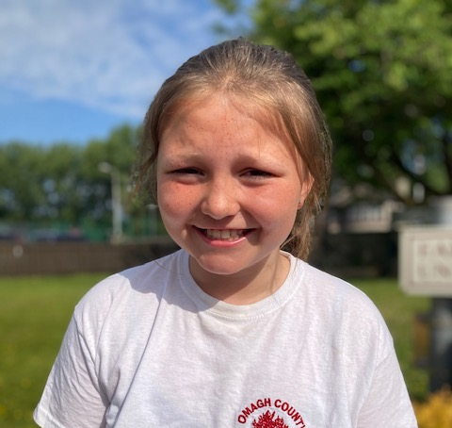
Payton
Marine Biologist

Slide 24
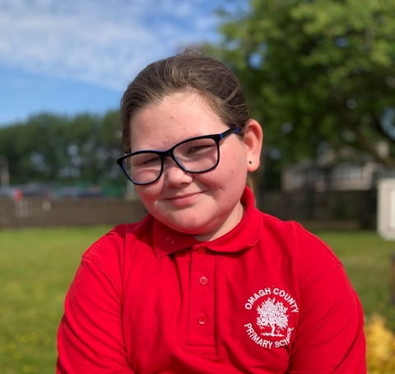
Mia
Petroleum Engineer

Slide 25
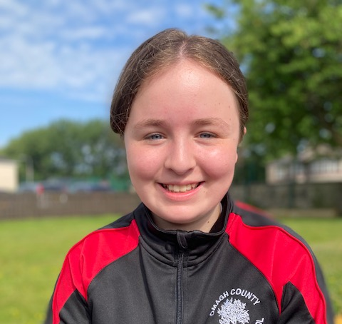
Bethany
Part Time Teacher and Part Time Farmer

Slide 26
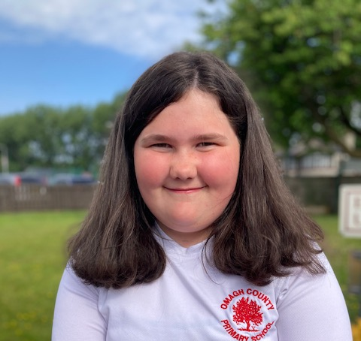
Aliya
Lawyer

Slide 27
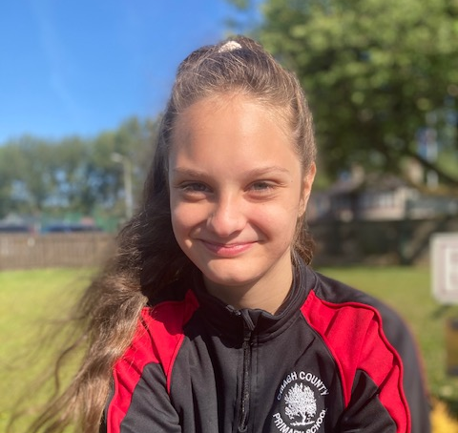
Csenge
Actress

Slide 28
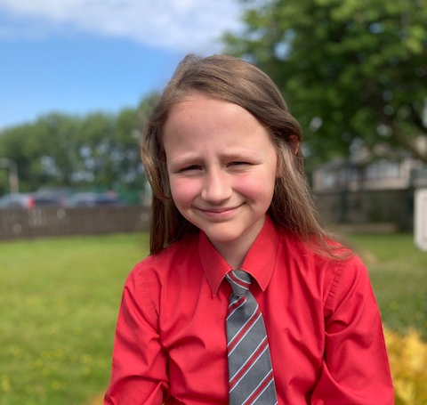
Ellie
Civil Engineer

Slide 29
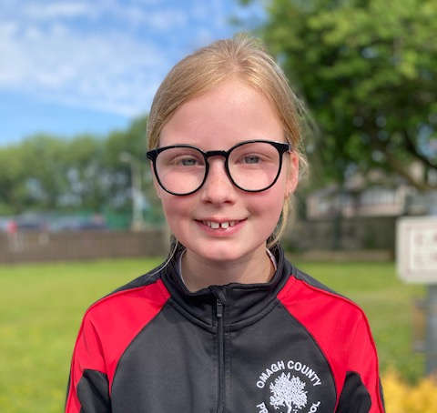
Grace
Childminder

Slide 30
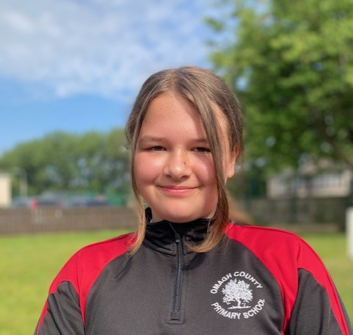
Sheila
Doctor

Slide 31
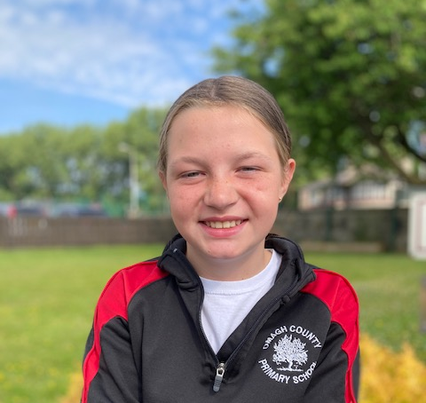
Leah
Artist

Slide 32
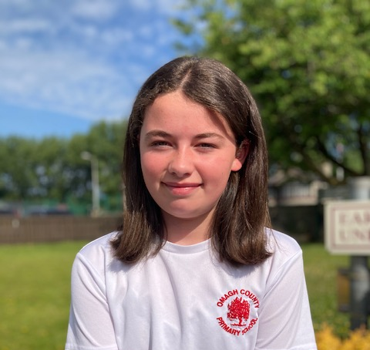
Cara
Dog Groomer or Dancer

Slide 33
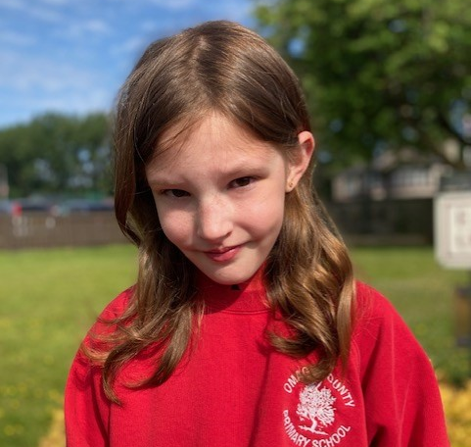
Lily
Midwife

Slide 34
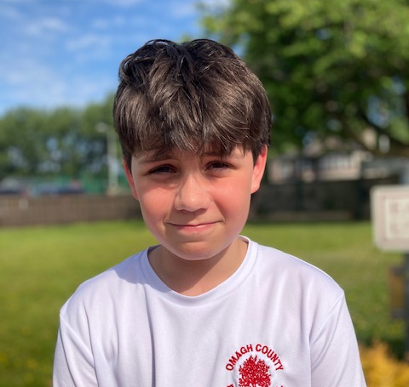
Tilson
RAF

Slide 35
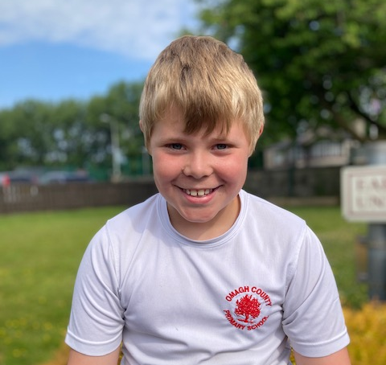
Craig
Air Force Pilot or Footballer

Slide 36
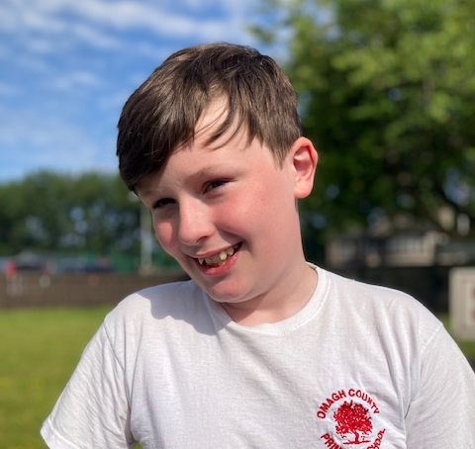
Sam
Architect

Slide 37
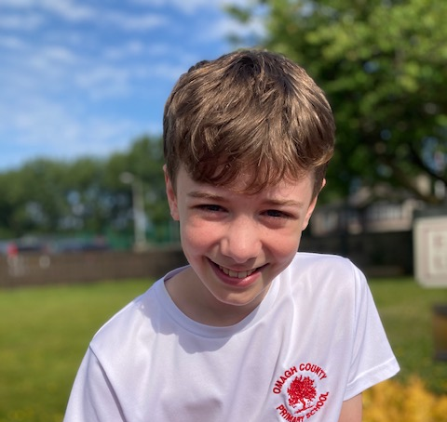
Michael
Chiropractor

Slide 38
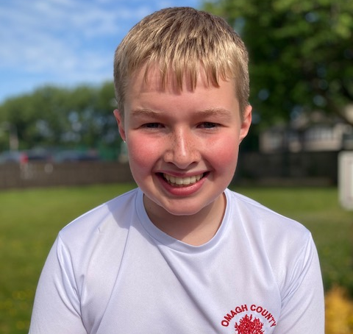
Mark
Site Engineer Manager

Slide 39
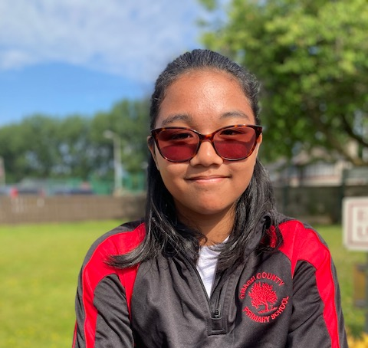
Cassey
Food Technician

Slide 40
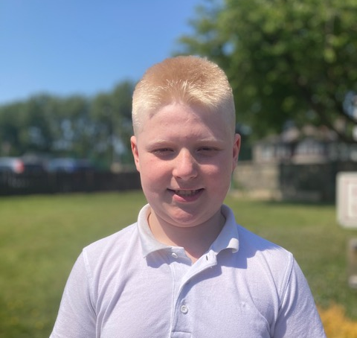
Anthony Sean
You-Tuber

Slide 41
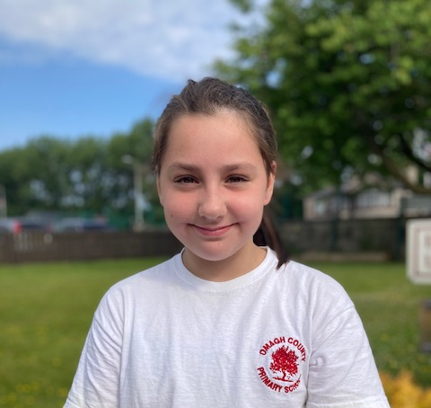
Jessica
Footballer

Slide 42
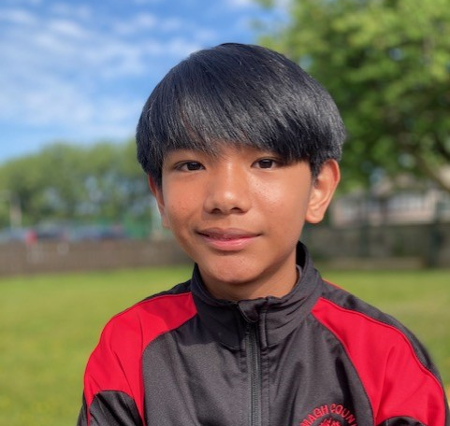
Vincent
Engineer

Slide 43
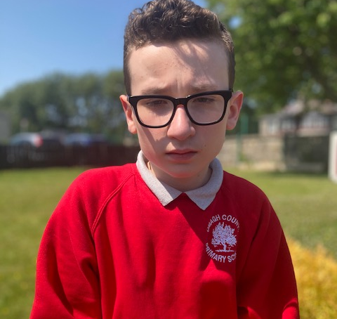
Cole
You-Tuber

Slide 44
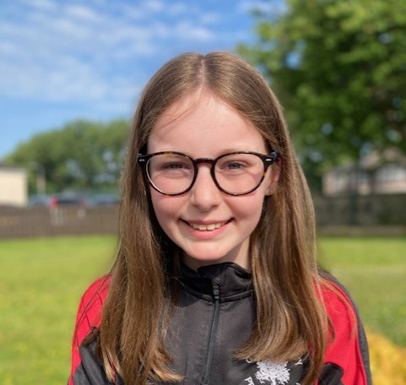
Sophie
Art Therapist

Slide 45
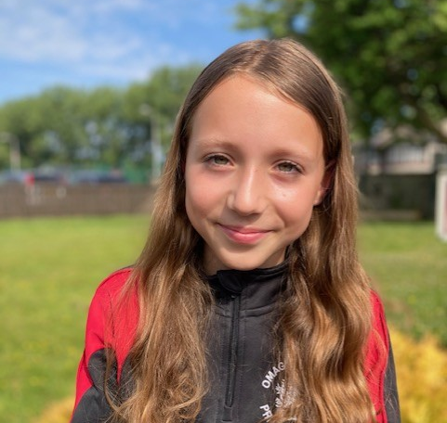
Isla
Actress

Slide 46
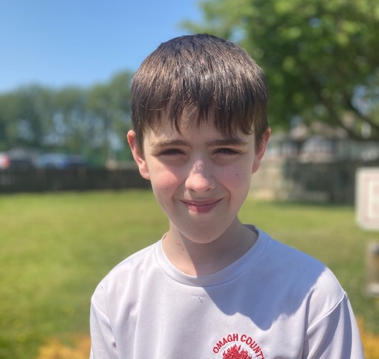
Gordon
Military

Slide 47
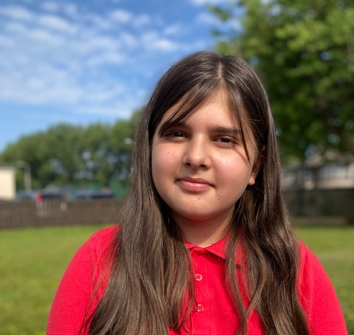
Laura
Lawyer

Slide 48
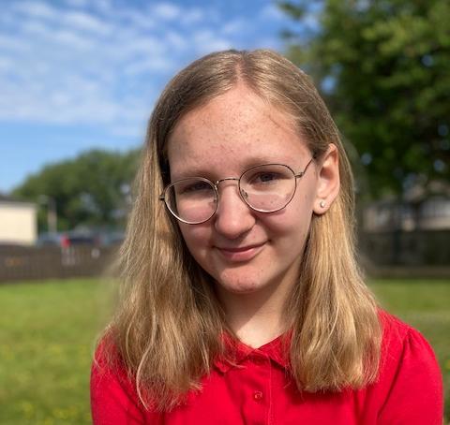
Zlata
Art Teacher

Slide 49
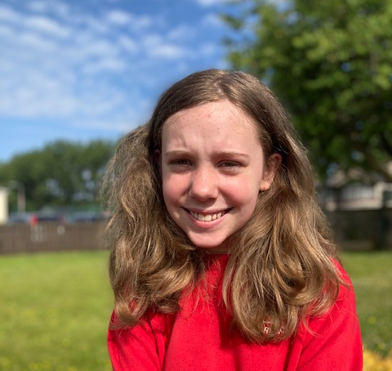
Demi-Lee
Therapist

Slide 50
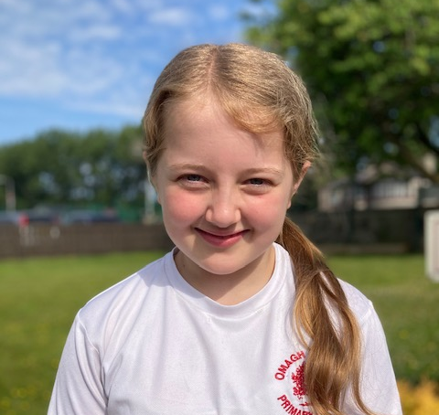
Emily
Day Care Centre Manager

Slide 51
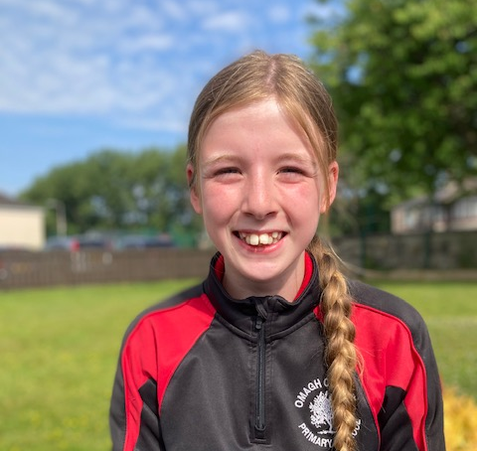
Jessie
Korean Pop Idol

Slide 52
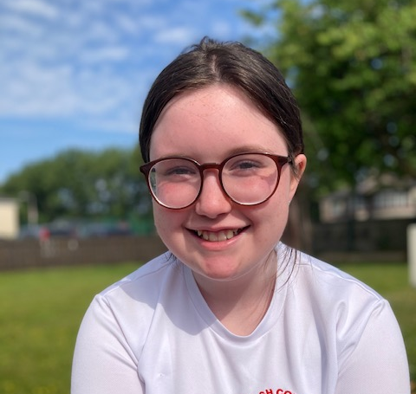
Mia
Nurse

Slide 53
Corey
Illustrator

Slide 54
Sarah
Author or Actress

Slide 55
Evie
Artist

Slide 56
Christina
Horse Rider

Slide 57
Angelina
Actress or Café Owner

Slide 58
Leah
Equine Vet

Slide 59
Callie
Horse Rider or Vet

Slide 60
Leah
Football Coach

Slide 61
Paulina
Interior Designer

Slide 62
The future is bright for the OCPS Stars of 2023!

